Slide 1
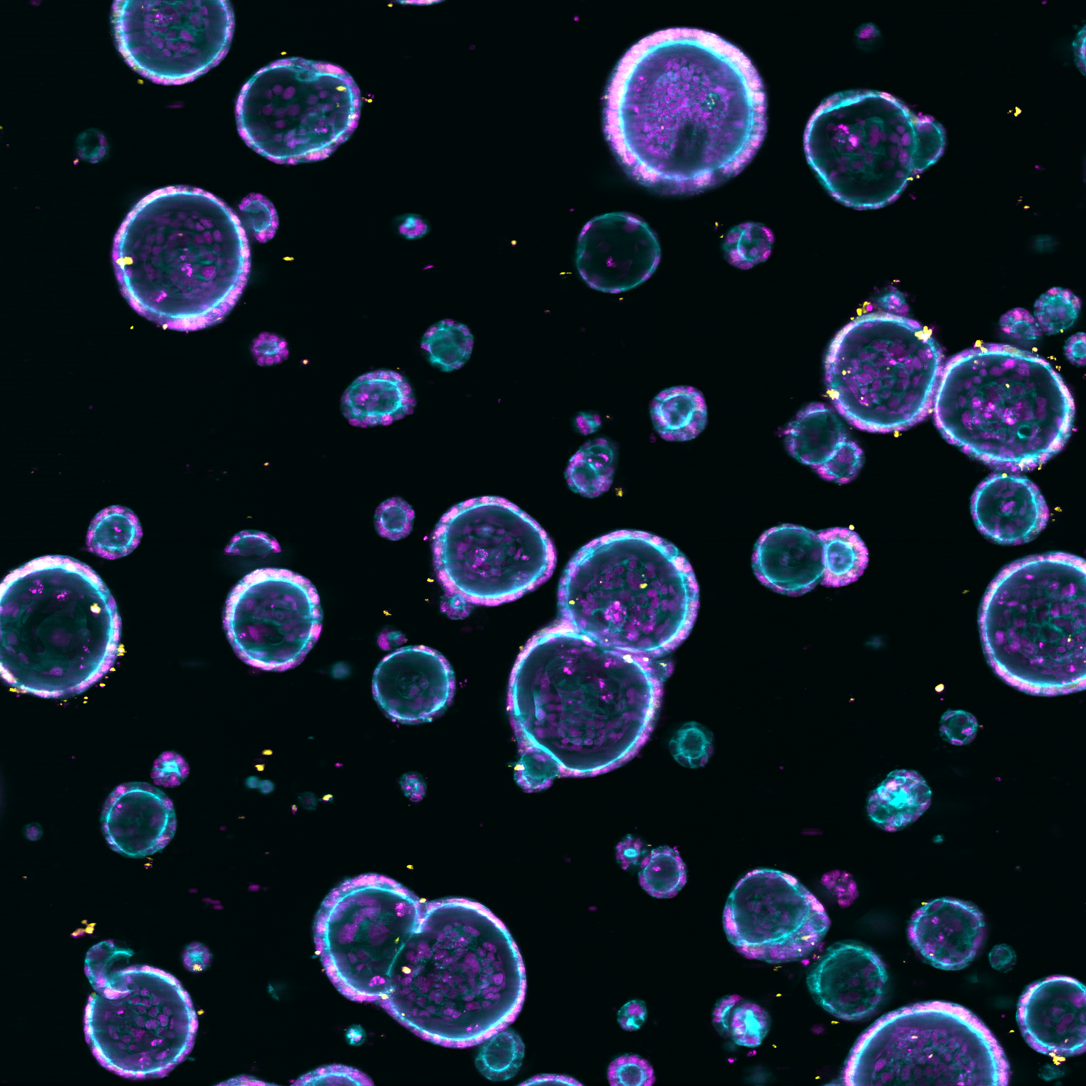

Phenotyping of drug effects in patient derived organoids
Niklas Rindtorff
Boutros Lab
@Niklas_TR

Slide 2
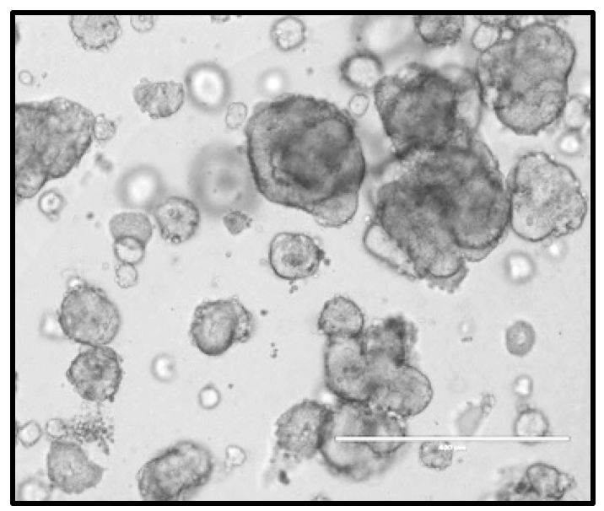
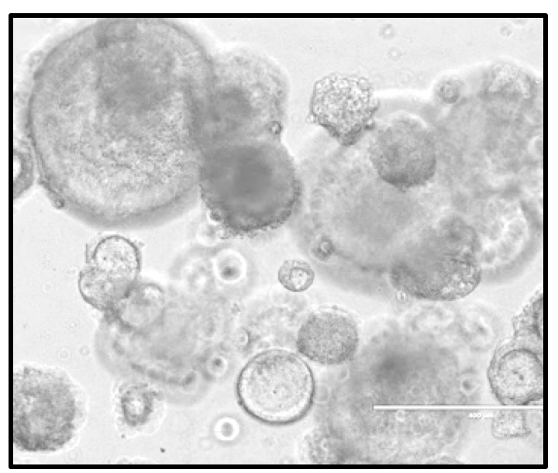
Patient Derived Organoids enable efficient ex-vivo cancer model development
FFPE colorectal cancer organoids, H&E staining

Slide 3
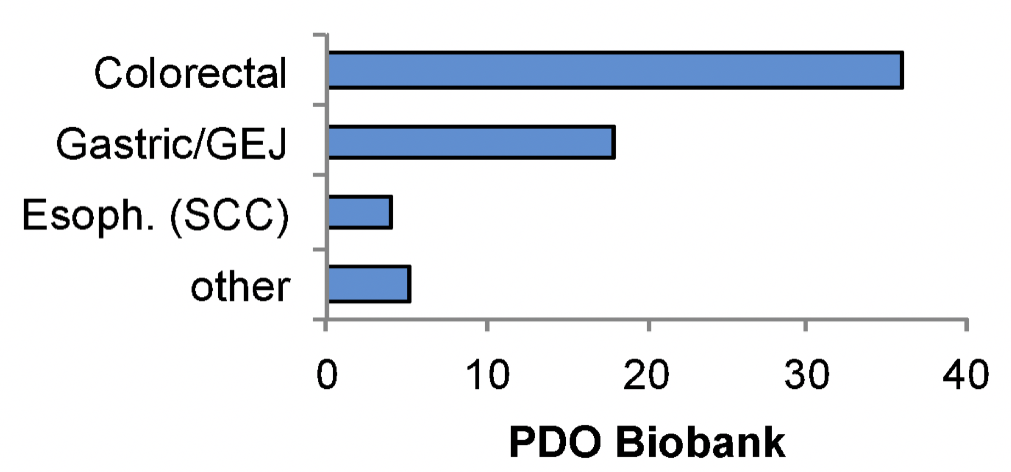
Patient Derived Organoids enable efficient ex-vivo cancer model development
>70 organoids incl. colorectal cancer, stomach cancer
Adapted from Organoids in cancer research, Drost & Clevers, 2018
Worldwide: <100 colon cancer cell lines
Since 2011: >250 colon cancer organoid lines

Slide 4

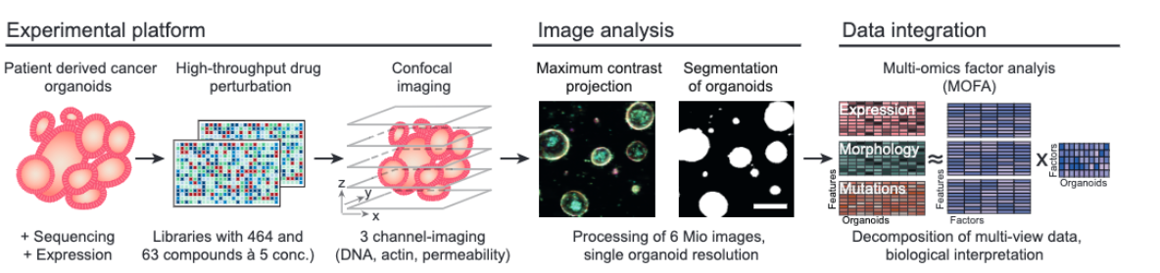
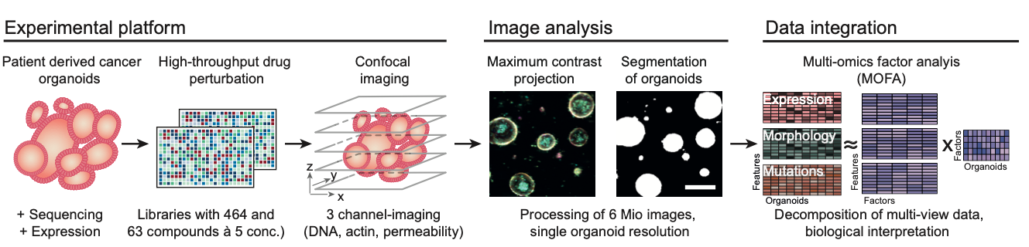
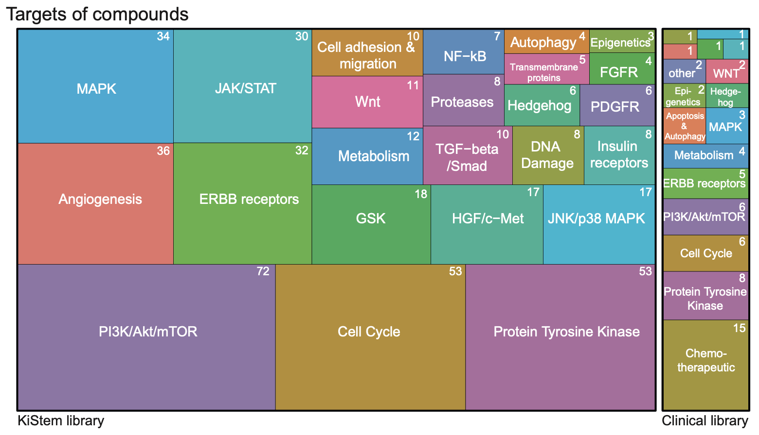
A technology to observe organoid phenotypes at scale

Slide 5

Image Analysis Process

Slide 6
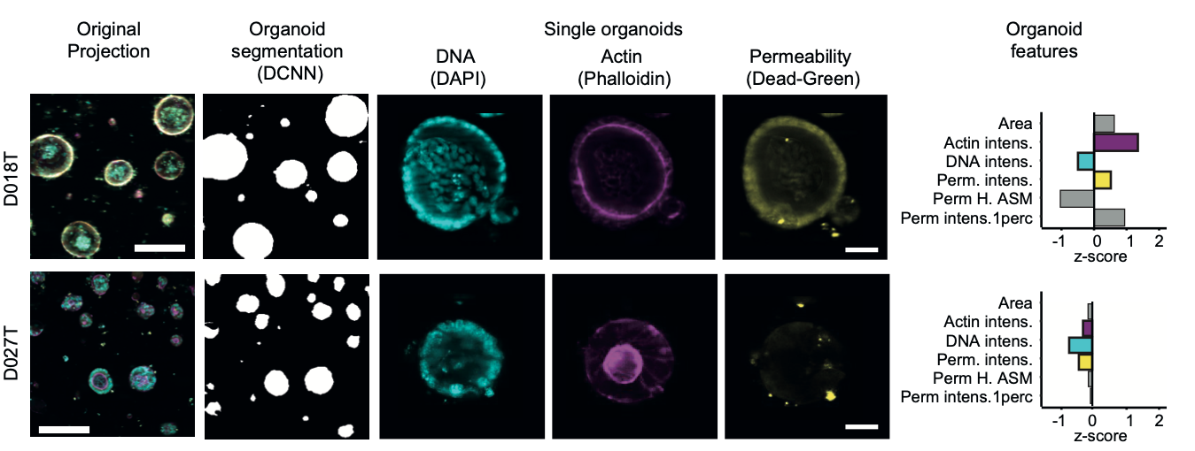
Image Analysis Process

Slide 7
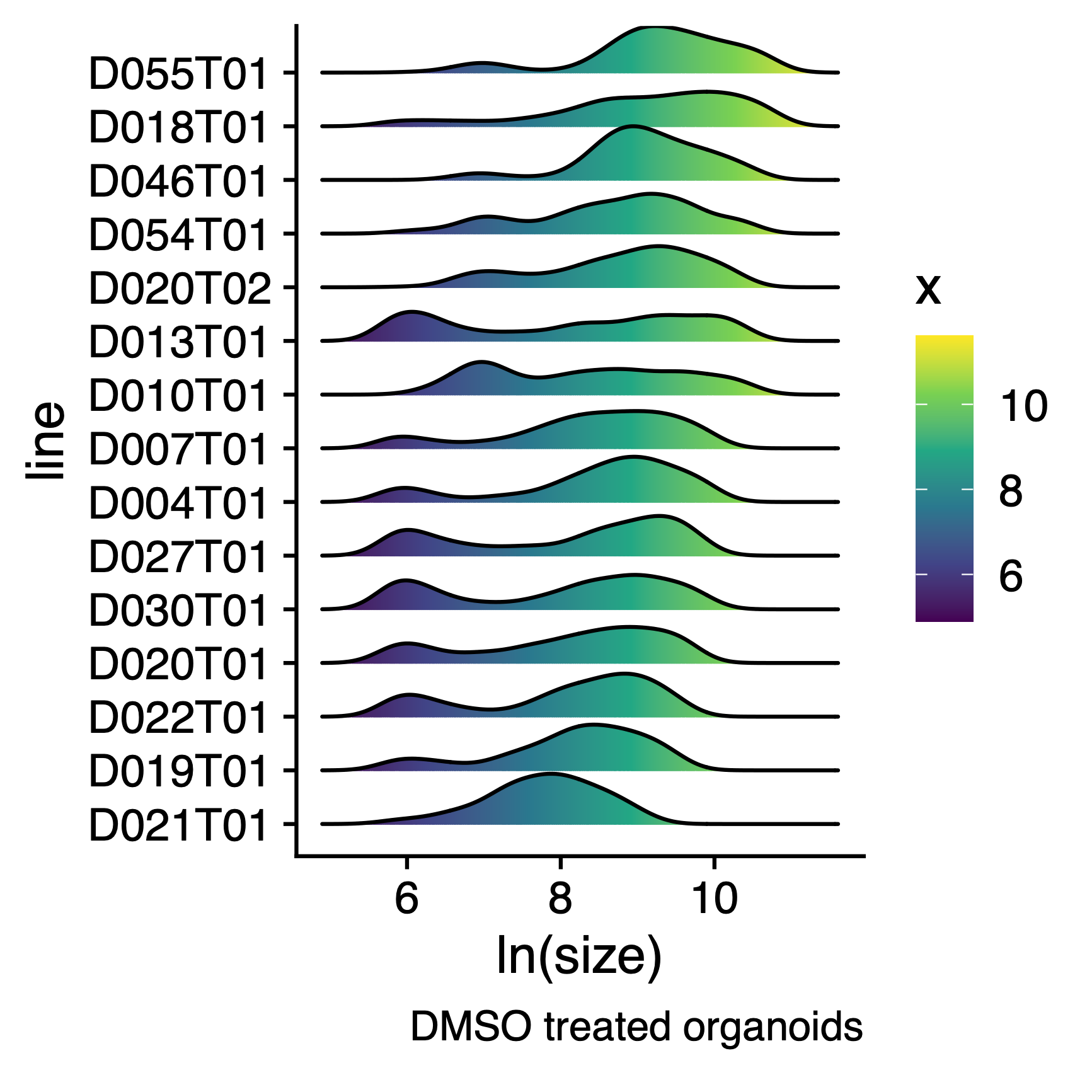


A Phenotypic Landscape of cancer organoids

Slide 8
A Phenotypic Landscape of cancer organoids
-4, -4

Slide 9
A Phenotypic Landscape of cancer organoids
-4, -4

Slide 10
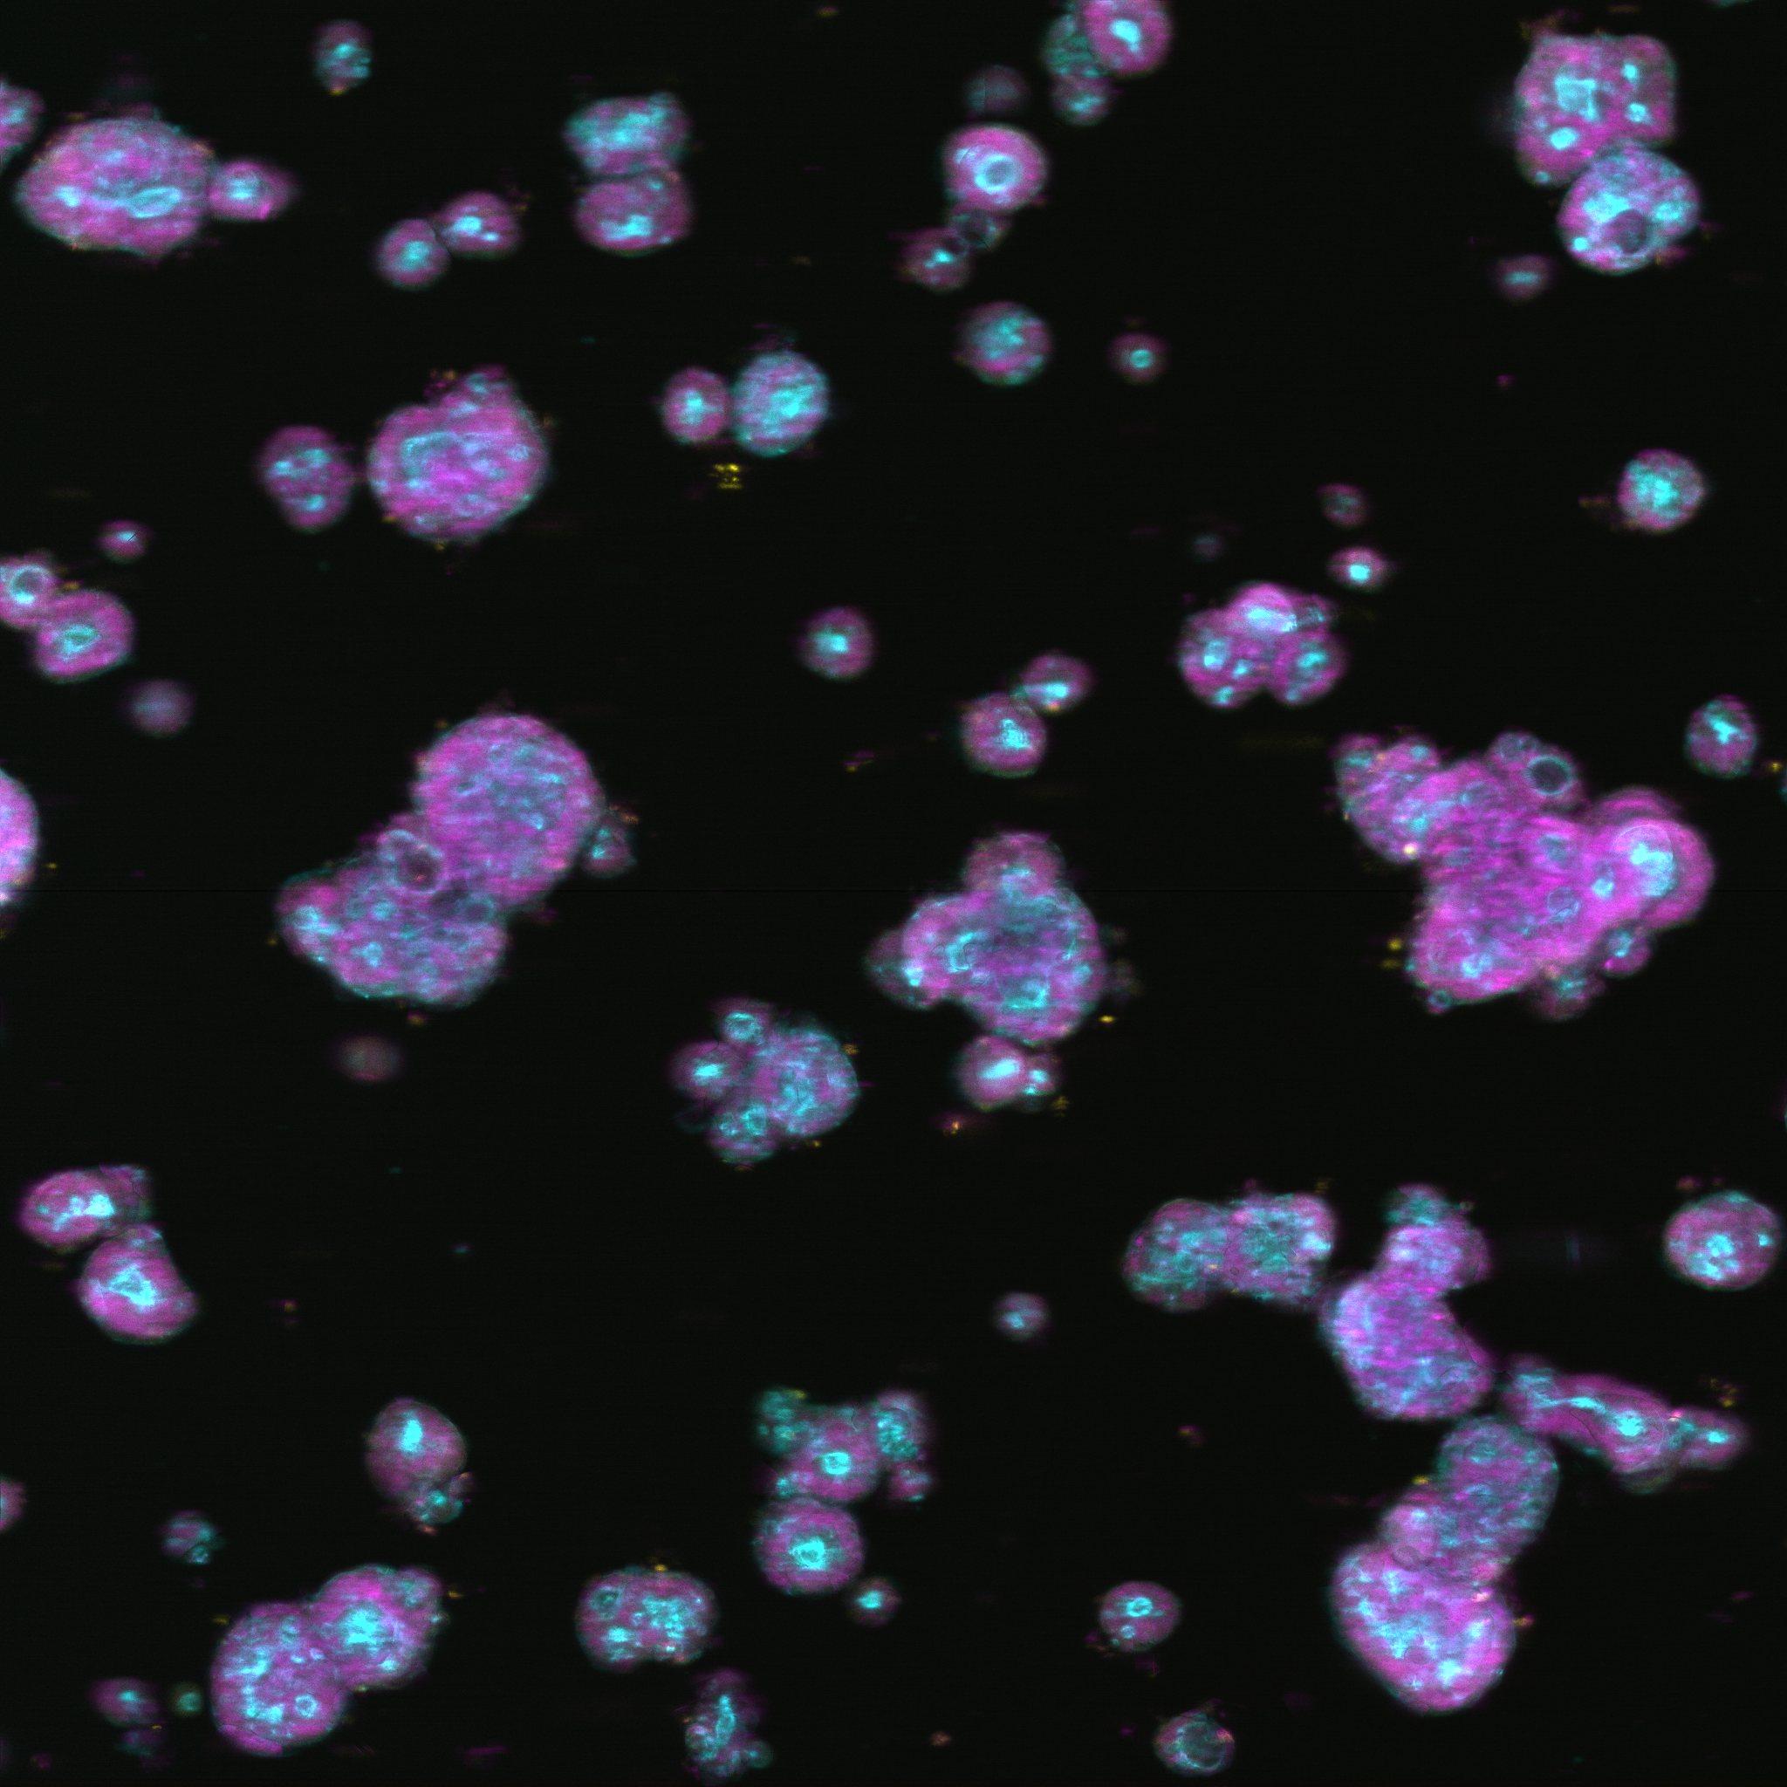
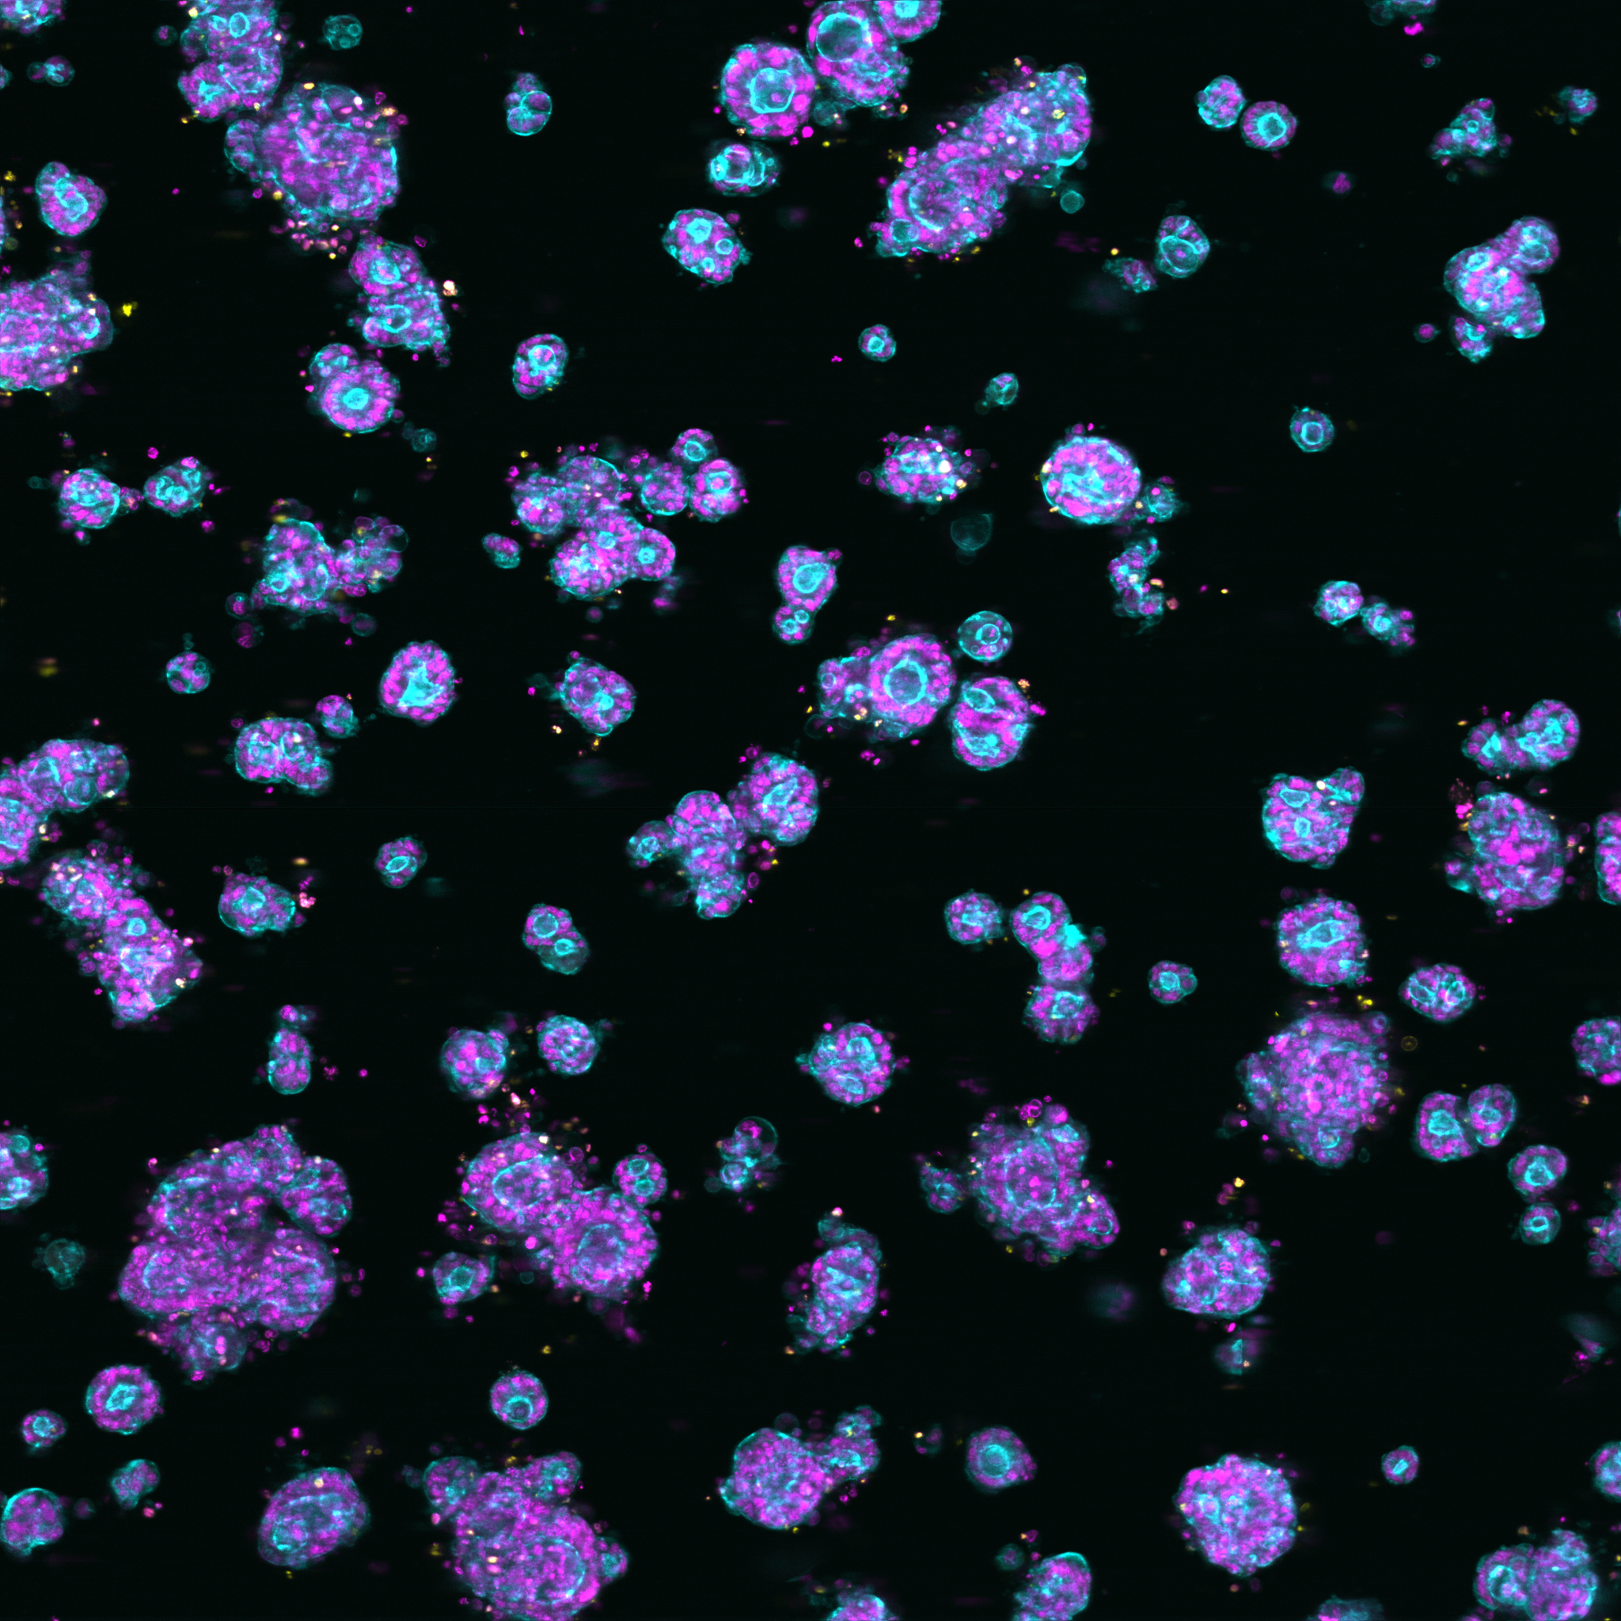
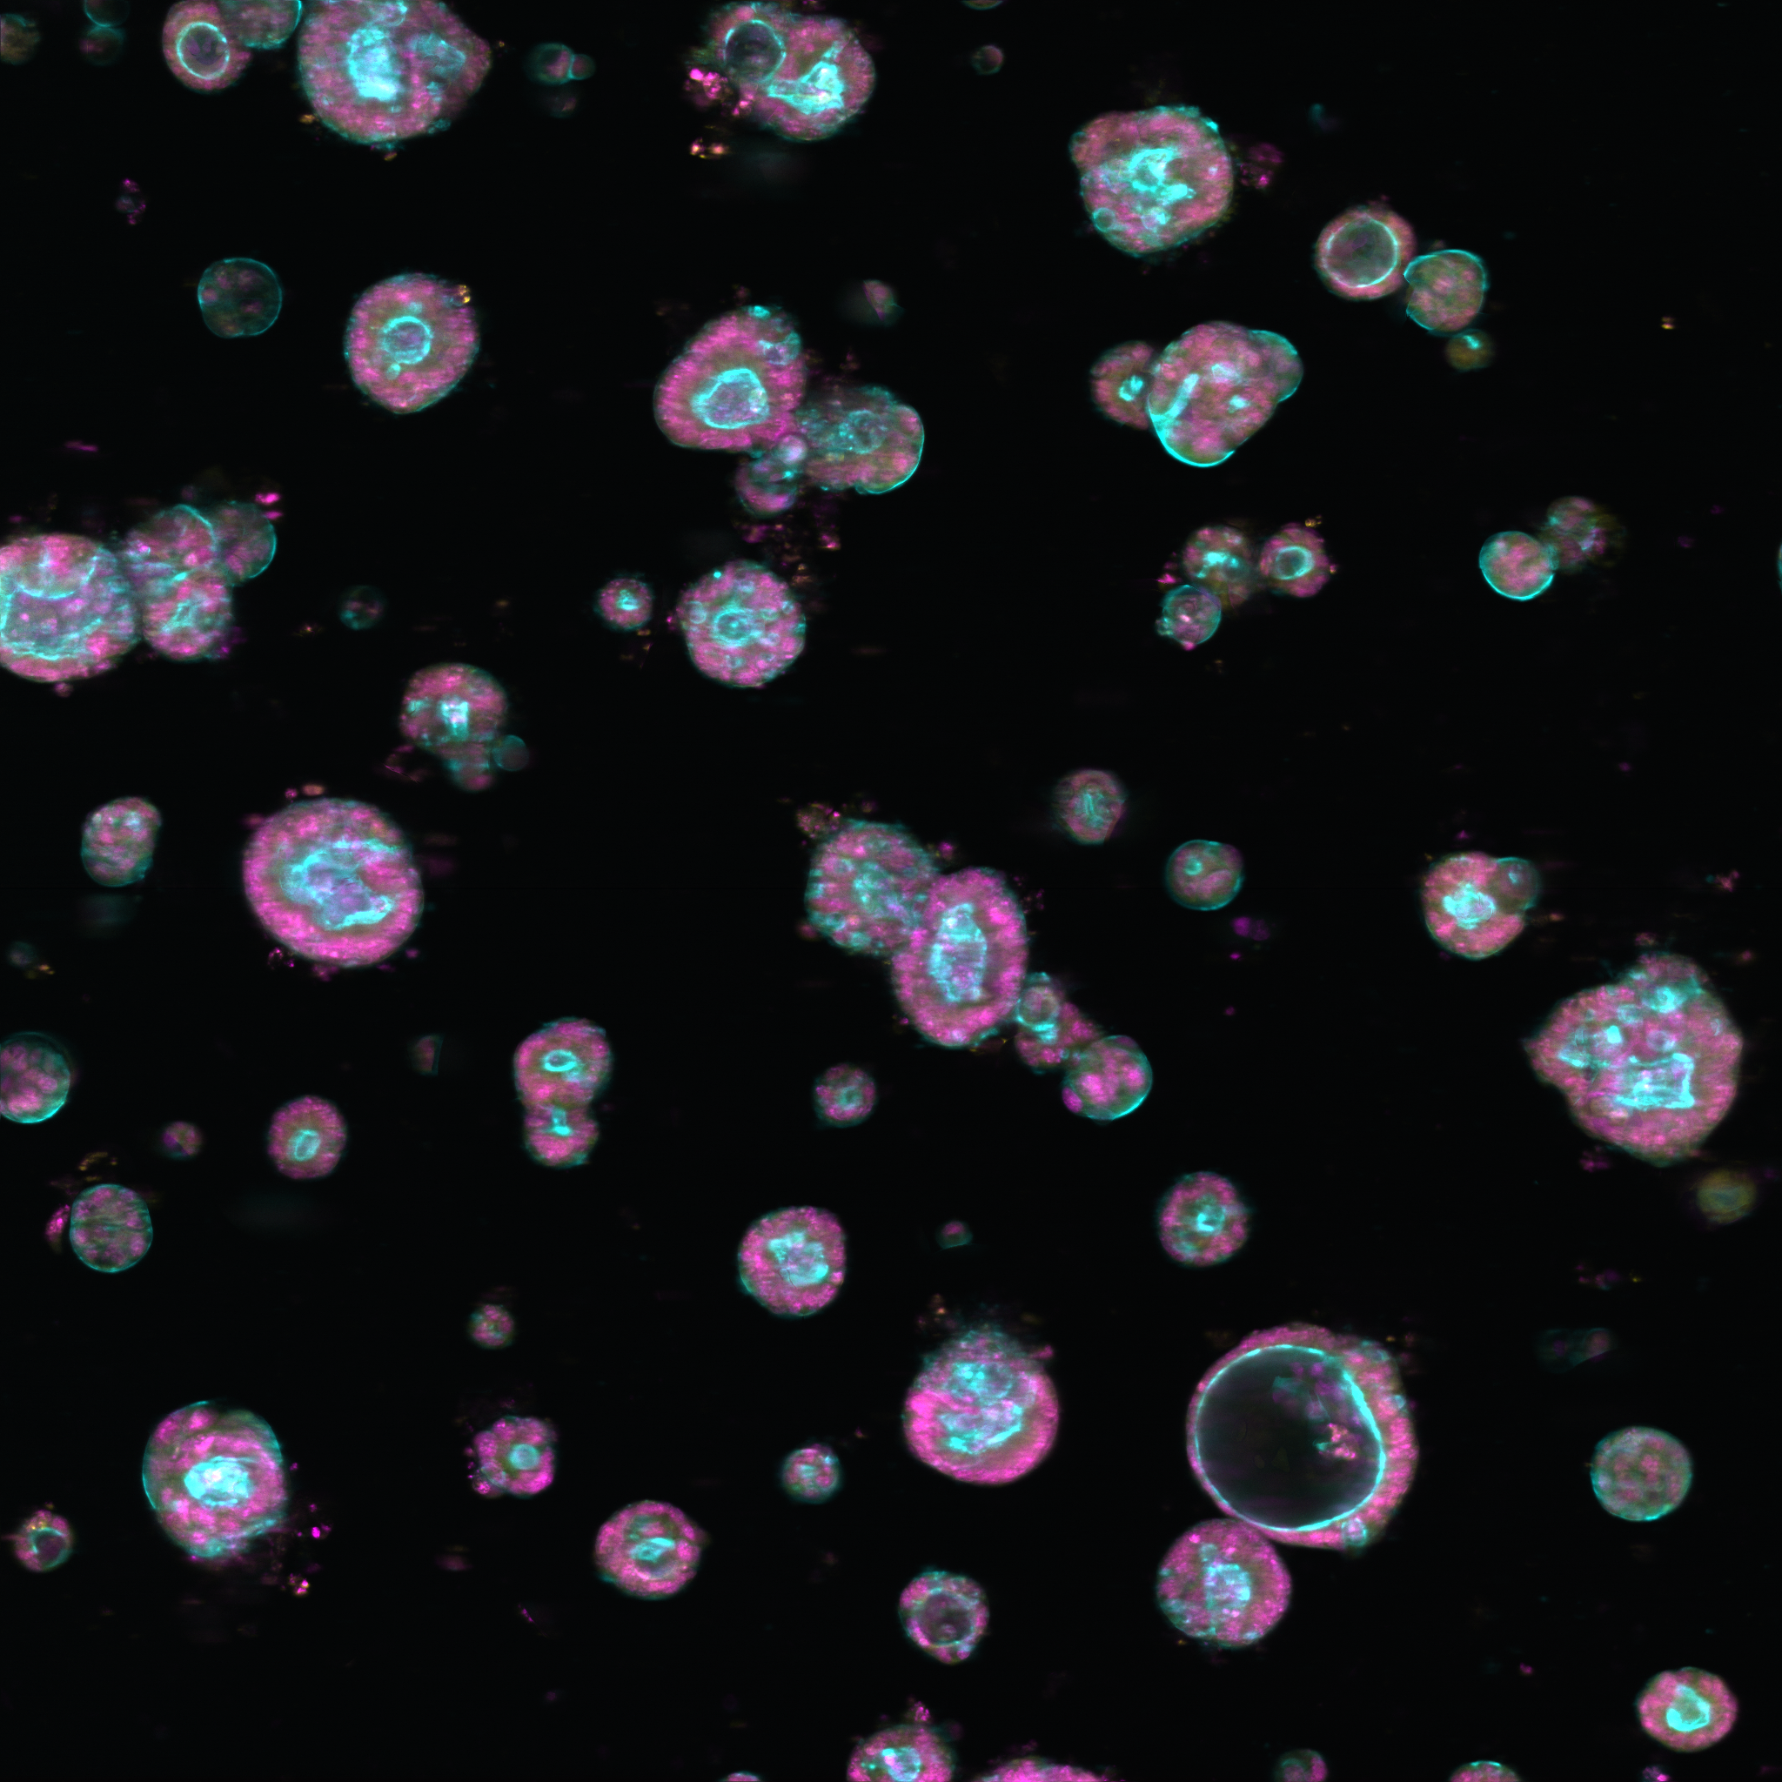
Organoid morphology varies by donating patient

Slide 11

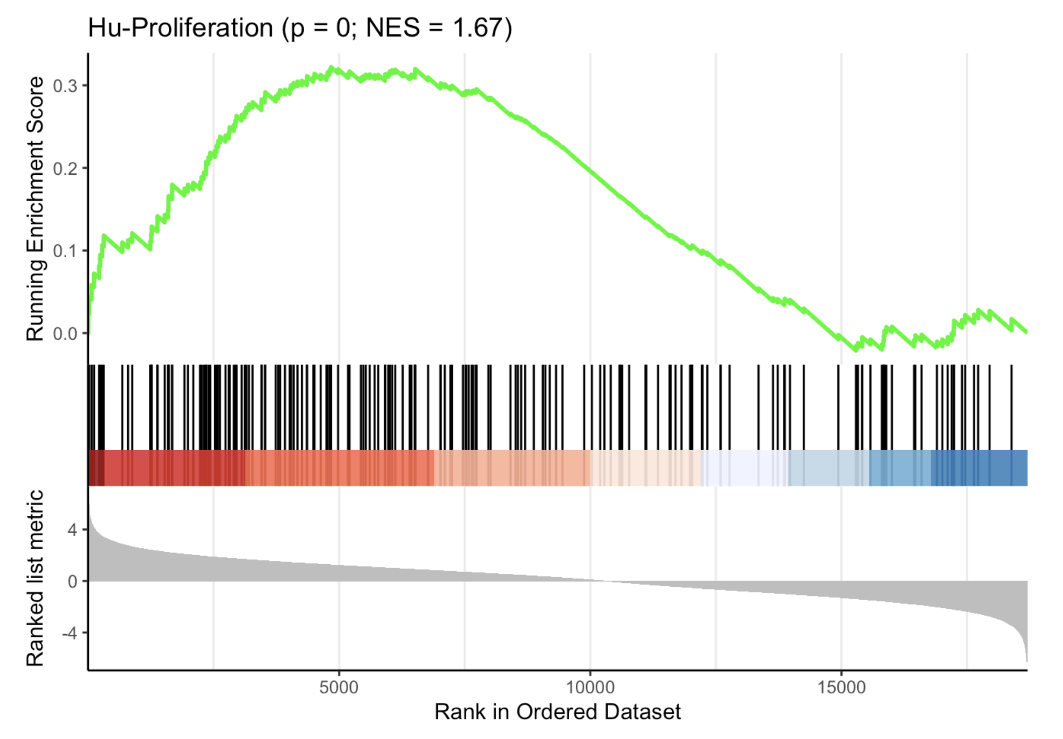
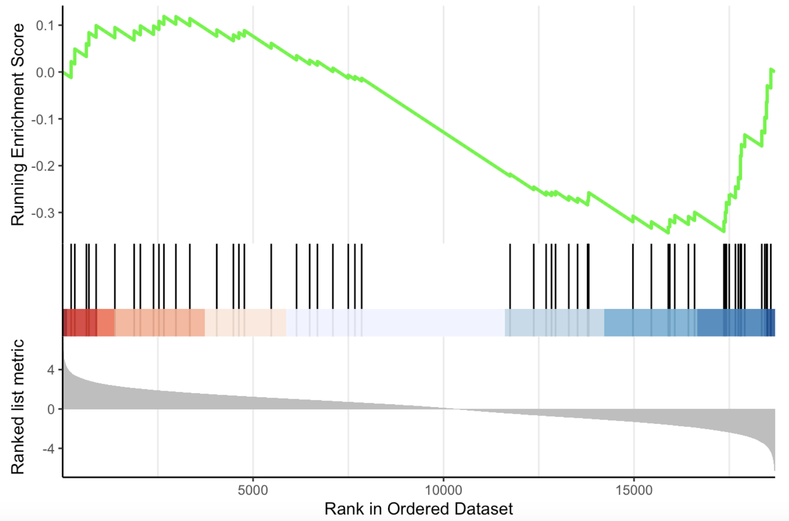
Molecular determinants of morphology
Proliferation
Stemness

Slide 12

Compound treatments lead to dose-dependent morphology changes

Slide 13


Supervised learning of drug induced organoid toxicity

Slide 14

Discovering drug induced phenotypes in organoids

Slide 15


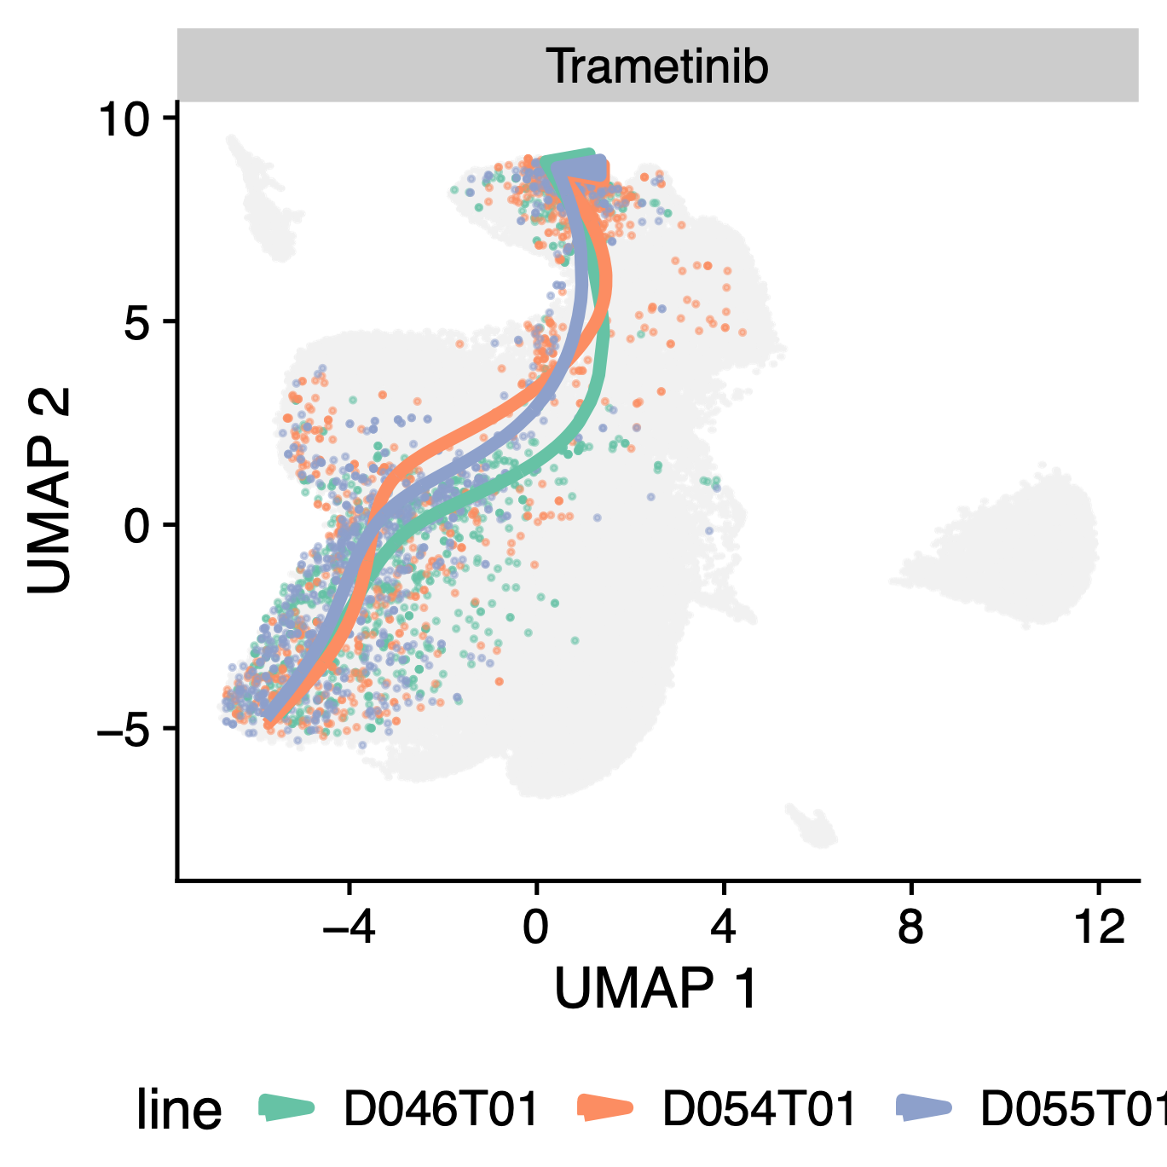
Biological mechanisms underlying organoid reorganisation

Slide 16
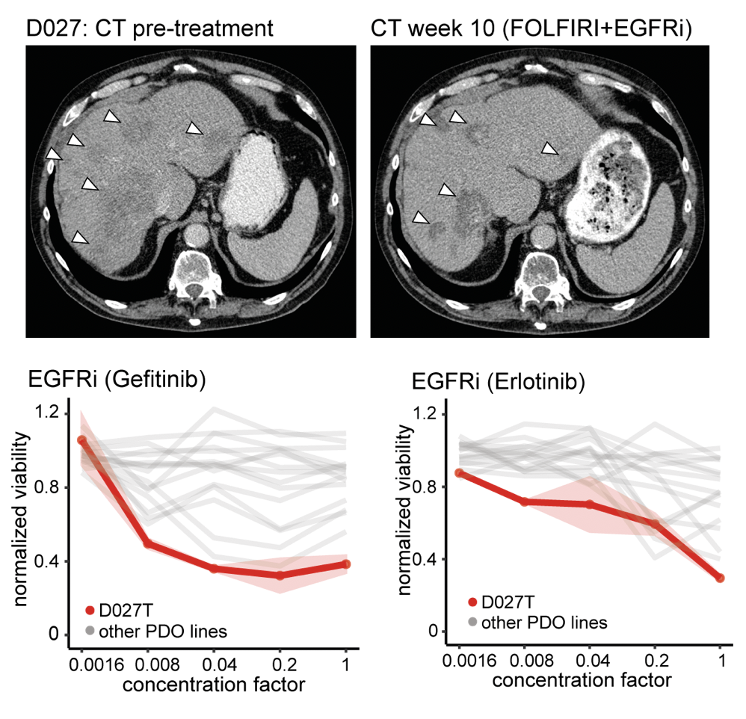
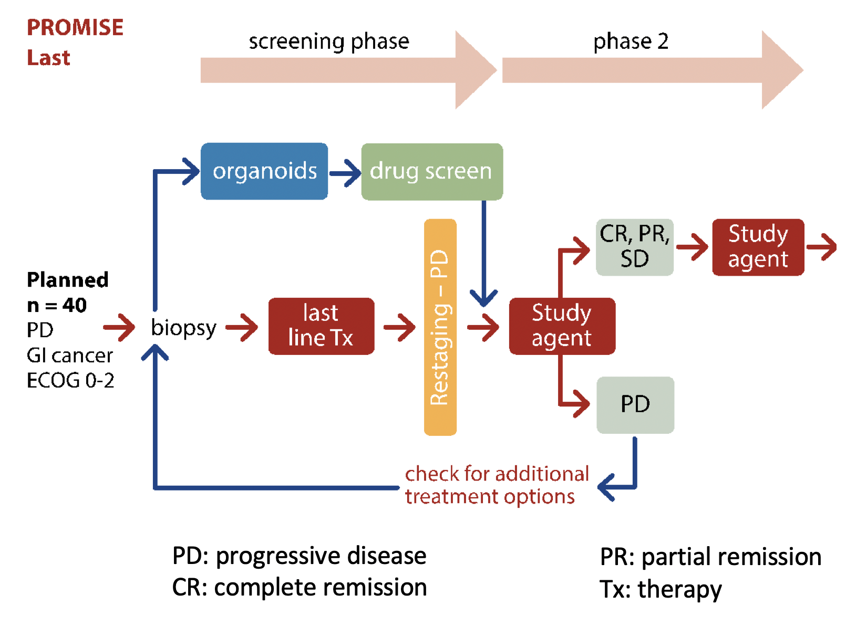
Outlook - Clinical technology transfer
Personalised Cancer Models

Slide 17

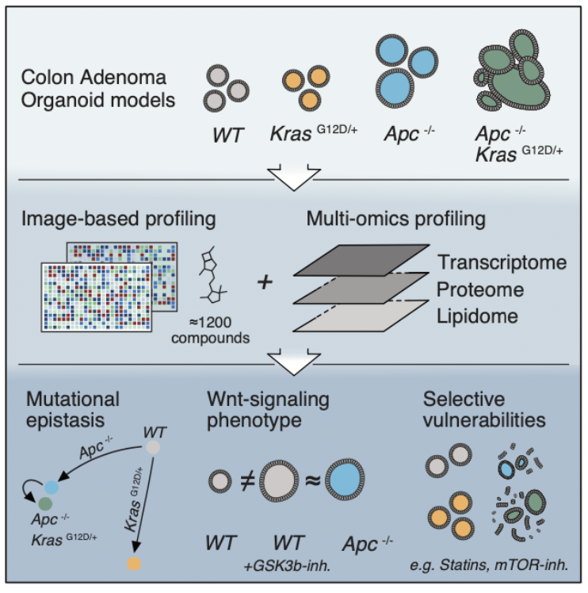
Outlook - Preclinical technology transfer
Drug Discovery and Dependency Testing
Step-by-step models of cancer

Slide 18

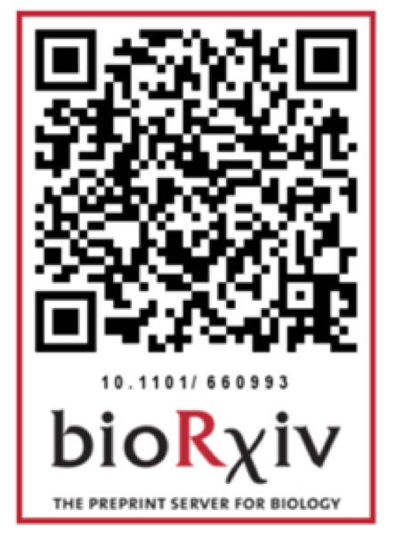

Acknowledgements
Michael Boutros
Johannes Betge
Jan Sauer
Benedikt Rauscher
Clara Dingert
Thilo Miersch
Alessio Falzone
Erica Valentini
Michael Endres
René Riedke
Tianzuo Zhan
Bernd Fischer († 2017)
Matthias Ebert
Elke Burgermeister
Katja Breitkopf
Kauthar Srour
Frank Herweck
Haristi Gaitanzi
Sebastian Belle
Nicolai Härtel
Inga Buchholz
Josephine Hodzic
Karin Kaiser
Ralf Jesenofsky
Veronika Hauber

Slide 19
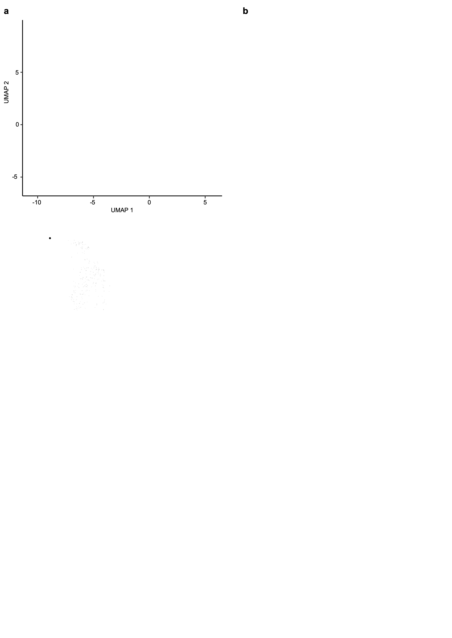
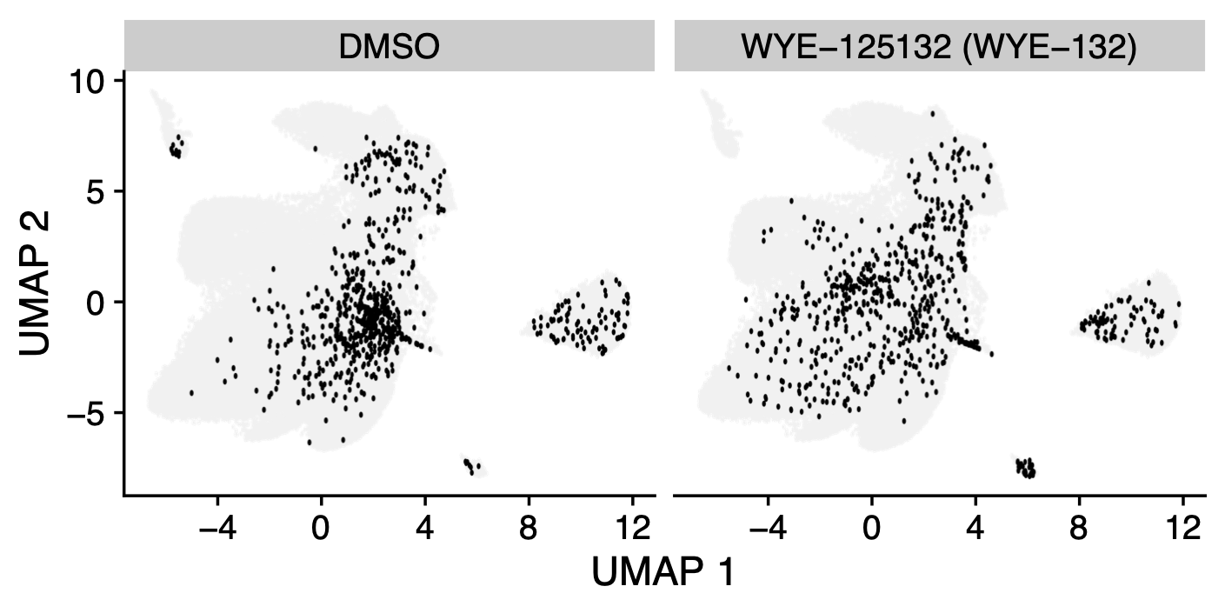
Loss of IFG-2 imprinting is linked to characteristic organoid morphology and can me modulated via specific mTOR inhibition

Slide 20
Identifying biological mechanisms underlying organoid reorganisation

Slide 22
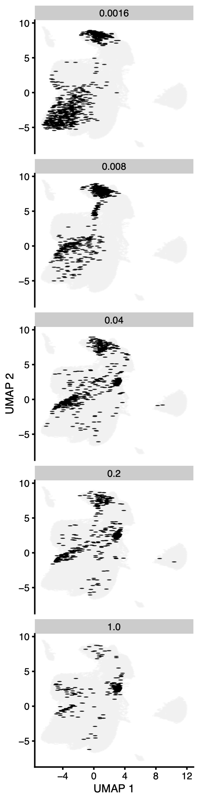
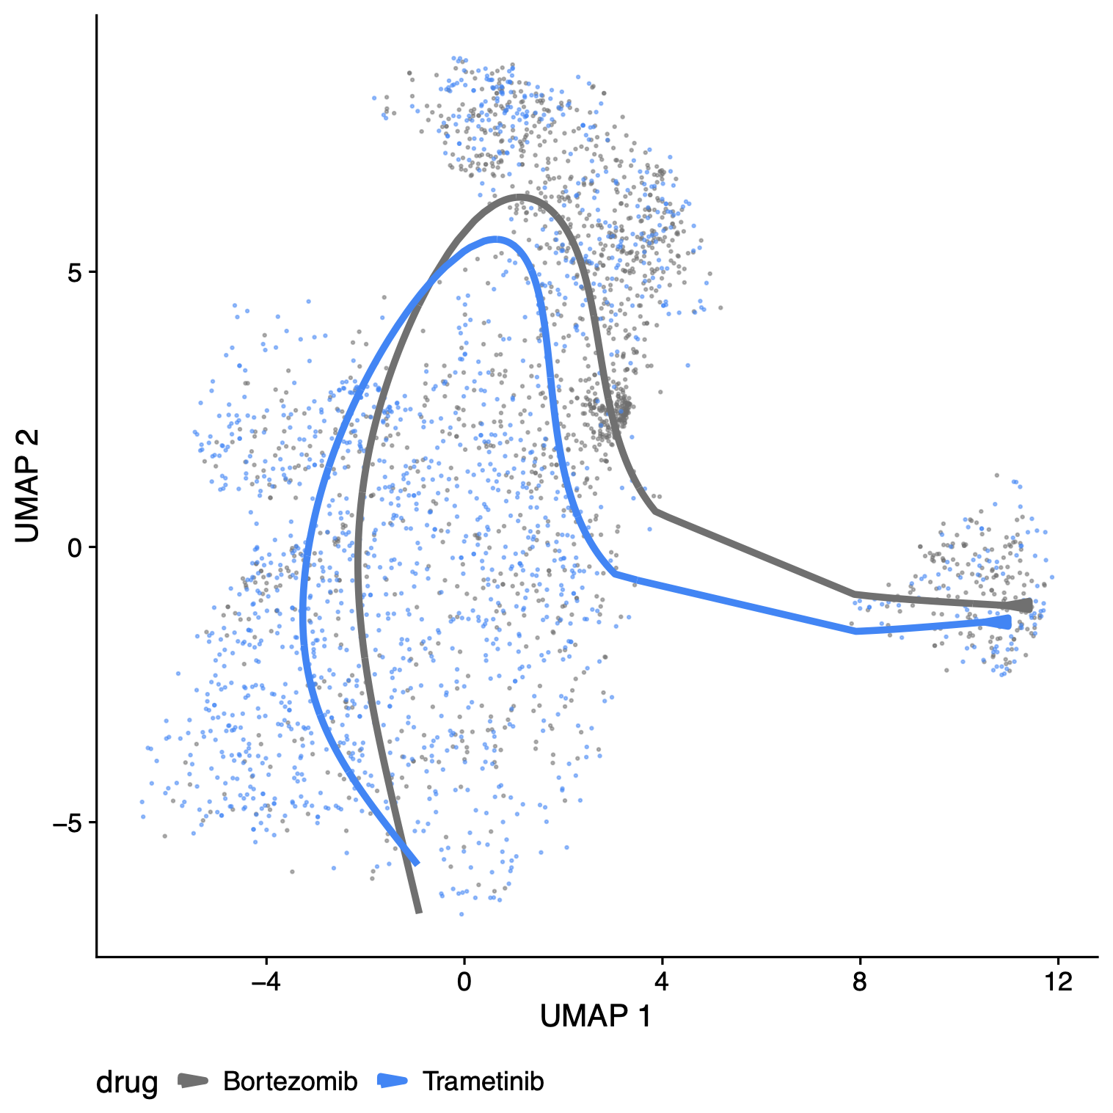
One line many drugs, Many drug one line

Slide 23

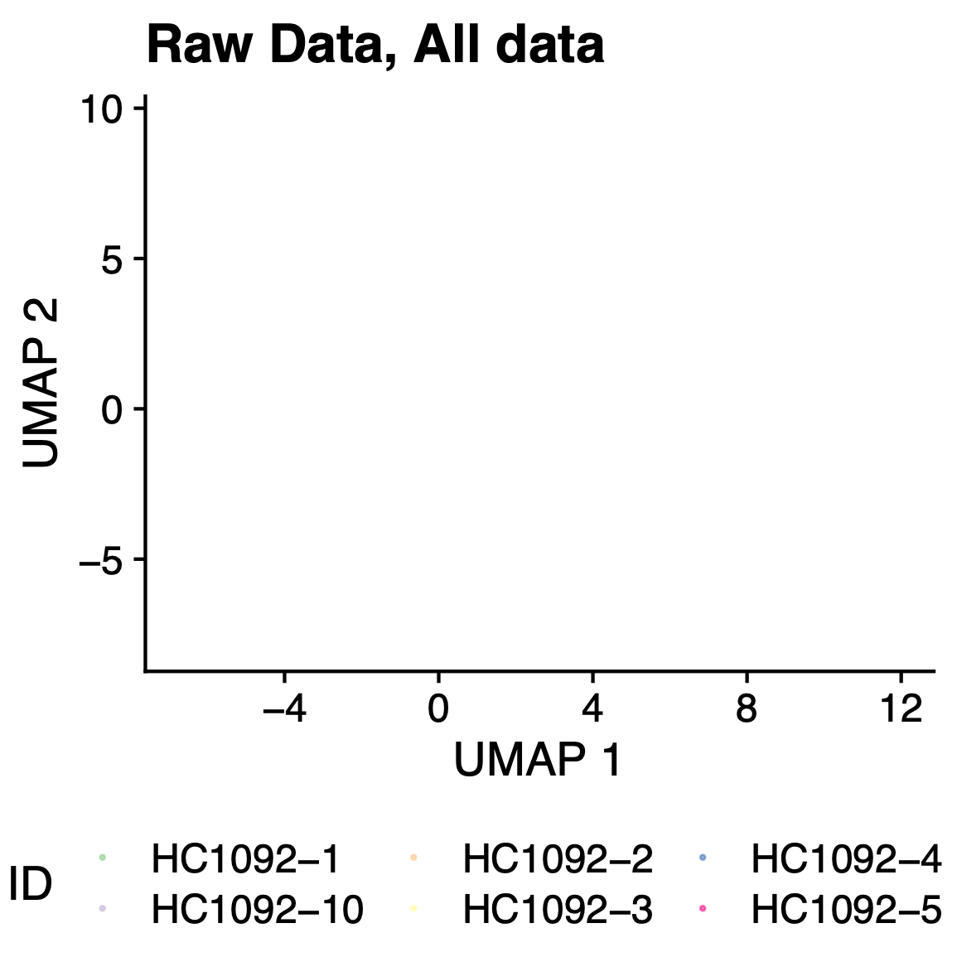
A Phenotypic Landscape of cancer organoids

Slide 24


Slide 25



Slide 26
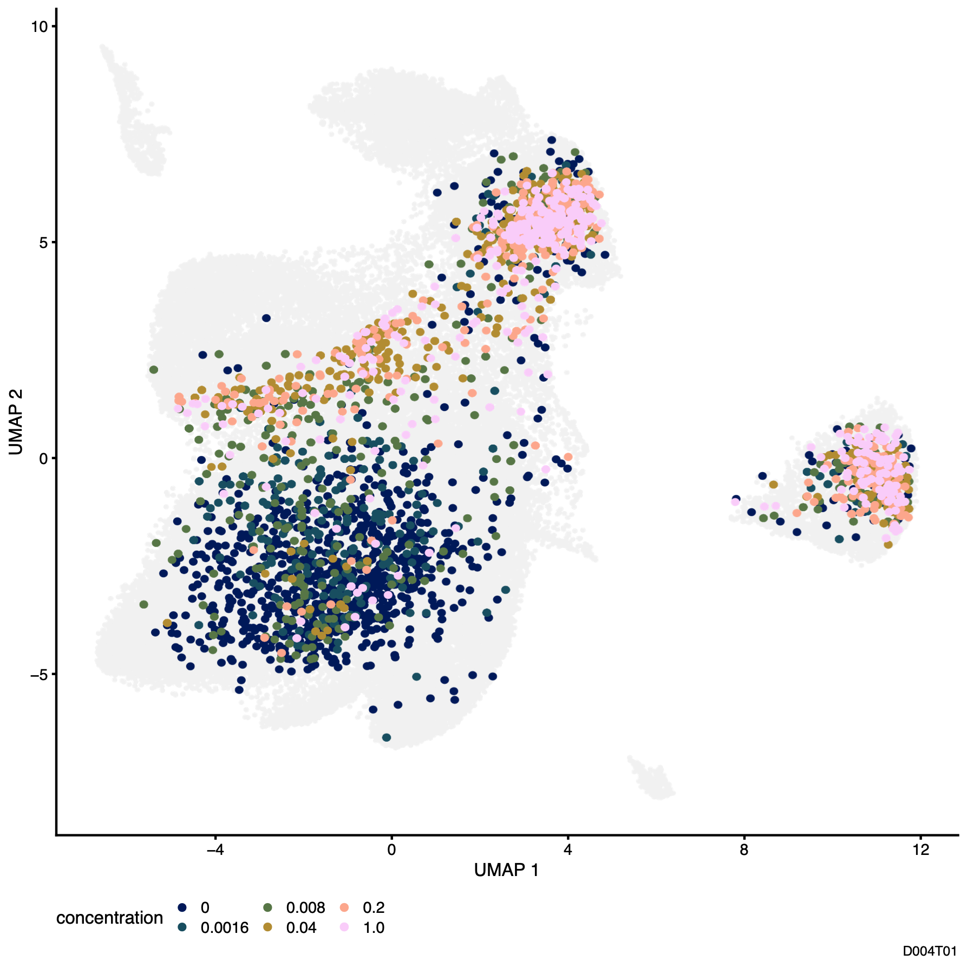
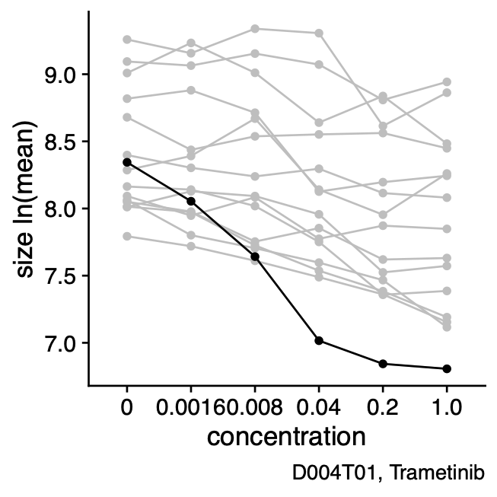
Compound treatment leads to dose-dependent morphological changes

Slide 27
Number of Organoids per well are log-norm distributed
DMSO treated organoids across all lines

Slide 28
Organoid size is approx. log-norm distributed
DMSO treated organoids across all lines

Slide 29
Organoid size fits a log-gaussian mixture model

